Slide 1
Teacher Notes
Remind student of process of connecting sphero(edu app -> connect ->Robot is BOLT not BOLT+ )
Students can work on the floor with sphero
Students Set Max Speed to 100 time to 1 sec
If sphero is not charged - use can use code.org (artist) or Scratch to simulate moving in a square, add variations of changing color, size, texture on each turn

Slide 2

Sequential Programming & Shape Creation

Slide 3
Core Objectives:
Connect to Sphero and understand basic controls
Create programs using sequential commands
Program Sphero to move in a complete square shape
Understand that commands happen in order

Slide 4
LESSON INPUT
What is Sequential Programming?
Commands that happen one after another in order
Like following a recipe: step 1, then step 2, then step 3
Each command waits for the previous one to finish

Slide 5
🎮 Example 1: Playing a Video Game Level
Imagine a simple game:
Press “Start.”
Your character walks forward.
You jump over a hole.
You collect a coin.
You reach the finish line.
🍪 Example 2: Making Cookies
Mix flour, sugar, and eggs.
Shape the dough into cookies.
Put them in the oven.
Wait 15 minutes.
Take them out and eat!

Slide 6
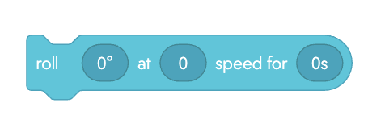



Your Challenge Today:
Make Sphero draw a perfect square using 8 movement blocks
Key concepts:
When start program
Roll (movement
Turn/Heading (direction)
Stop

Slide 7
CORE ACTIVITY
Building Your Square Program
Plan Your Square: 4 equal sides, 4 corners.
Each corner = 90-degree turn.
Your Program Structure:
WHEN start program →
Roll forward 2 seconds →
Turn 90 degrees →
Roll forward 2 seconds →
Turn 90 degrees →
Roll forward 2 seconds →
Turn 90 degrees →
Roll forward 2 seconds →
Turn 90 degrees
Test and Debug:
Does Sphero return to start position?

Slide 8
MINI PLENARY
Check Your Understanding
How many blocks did you use? Count them!
What happens if you change 90 degrees to 45 degrees?
Why do we need "When start program"?
What angle would you need for a triangle?

Slide 9
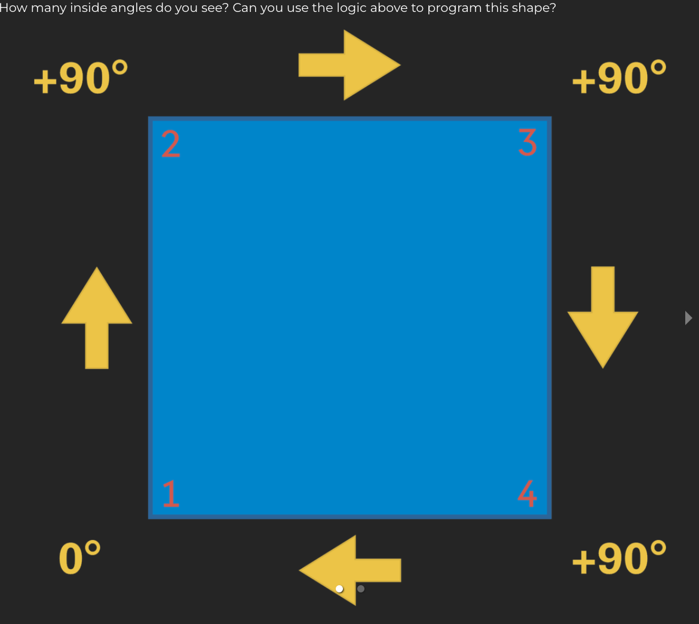
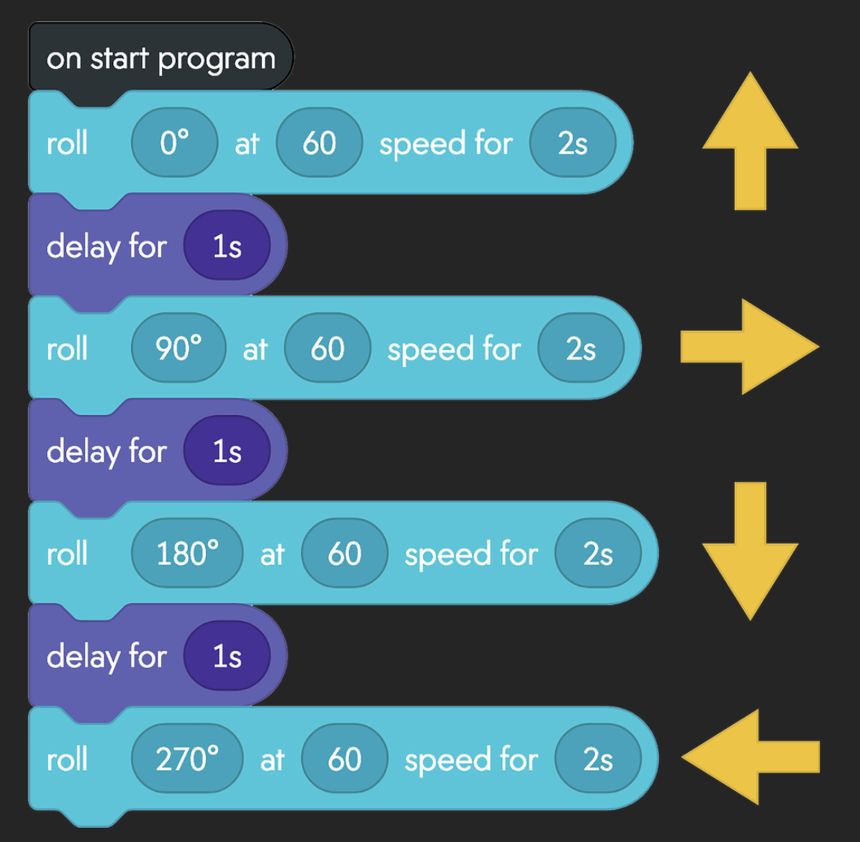
EXPLAIN THE RELATIONSHIP

Slide 10
CHALLENGE CARDS
MILD Light Show Square
MEDIUM Triangle Master
HOT PolygonDesigner
Create pentagon (5 sides) or hexagon (6 sides)
Add LED color changes to each corner
Create triangle with 120-degree angles
Different color for each turn
Calculate angles: 360 ÷ number of sides
Return to starting position
Make your square visual!
Explain Why triangles need diff angles
Show your mathematical working
Answers

Slide 11
PLENARY
Prove Your Programming Skills
What is sequential programming?
Why does command order matter?
What if "stop" was at the beginning?
How is programming like giving directions?

